Slide 1

AI Story Generator Using GPT-2 And Deep learining
Semi OFFLINE, Genre-Based, Text-to-Speech Enabled Story Creation
SANKETIKA VIDYA PARISHAD ENGINEERING COLLEGE
Guided by
Ms. B.Kumari
Asst Professor MCA
Presented by
Vanapalli Prasanth Kumar
Regd.No:323232960064

Slide 2
Table of Contents
1. Introduction
2. Existing System
3. Drawbacks in Existing System
4. Proposed System
5. Abstract
6. Software & Hardware Requirements
7. Brief Description
8. Activity Diagram
9. Class Diagram
10. Use Case Diagram
11. Output Screenshots
12. Conclusion
13. Thank You

Slide 3
INTRODUCTION
The AI Story Generator is an innovative web-based application designed to help users create imaginative and coherent stories based on custom prompts and genres.
By leveraging advanced AI language models such as GPT-2, GPT-Neo, and afshaan/AIstoryGenerator-v2, the system generates human-like stories with minimal input.
It enhances user experience with features like:
Genre-based model selection
Text-to-Speech playback using JavaScript (Web Speech API)
Story continuation capability
Cloud-based MongoDB for storing and managing story history
The project blends natural language generation with a user-friendly interface, offering a practical and semi-offline solution for interactive storytelling.

Slide 4
Existing System
- Tools like AI Dungeon and NovelAI are widely used for AI-based story generation
- genre-specific customization in most platforms
- Cannot save or revisit stories
- No offline TTS support

Slide 5
Drawbacks in Existing System
- Internet dependent
- No user personalization
- No voice playback
- No history or story continuation

Slide 6
Proposed System
- genre-specific story generation
- Integrated TTS via JavaScript web speech Api
- MongoDB story history
- Flask-based UI
- Story continuation support

Slide 7
Abstract
The AI Story Generator is an intelligent tool that uses artificial intelligence to create storylines and plots based on user input. By selecting a specific category and world, users can generate unique narratives that align with their chosen genre. Once selected, the category and world remain fixed for that story, and any changes require starting a new project. The system saves progress automatically, helping users avoid data loss. This tool is especially helpful for content writers and novelists facing creative blocks, as it generates engaging stories using machine learning and natural language processing. With its ability to create personalized and compelling narratives, the AI Story Generator has the potential to transform storytelling across media, including video games, virtual reality, education, and marketing.

Slide 8
SOFTWARE REQUIREMENTS
Python 3.10+ Used to build the app
Flask To create and run the web application
Transformers (Hugging Face) For AI models like GPT-2, GPT-Neo, and afshaan
JavaScript (Web Speech API) For reading the story aloud in the browser
MongoDB (Cloud or Local) To save and manage story history
HTML & CSS To design the web pages and user interface

Slide 9
HARDWARE REQUIREMENTS
CPU: Dual-core or higher
RAM: 4GB or more (for better performance)
Storage: At least 1GB (for storing models)
Speaker: To hear stories using Text-to-Speech
Internet: Needed only if using MongoDB Atlas (cloud database)

Slide 10
Brief Description
- User inputs a prompt and selects genre
- Local AI model generates a story
- Flask handles app logic
- JavaScript tts Api handles speech
- MongoDB stores story data
- History and continuation supported

Slide 11
Algorithm
User Input:
User enters a prompt and selects a genre (e.g., horror, fantasy)
Model Selection:
Based on genre, a local AI model is chosen (e.g., GPT-2, GPT-Neo, or afshaan)
Story Generation:
AI model generates a story using NLP and transformer-based algorithms
Parameters like max length and sampling control the output
Output Display & TTS:
Story is shown on the web page
JavaScript (Web Speech API) reads the story aloud in the browser
‘;
Save to Database:
Story, genre, and timestamp are saved in MongoDB
User can view or manage story history

Slide 12
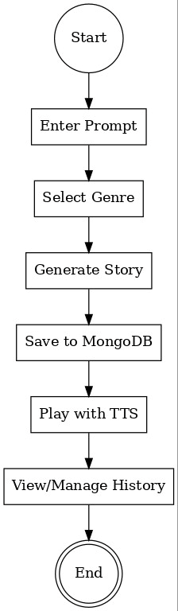
Activity Diagram
The Activity Diagram shows the flow of actions in the AI Story Generator. It starts with the user entering a prompt and selecting a genre. Then, the system generates the story using the appropriate AI model. After generation, the story is saved to the database, and the user can either listen to it using TTS or view it in the history section. This diagram helps visualize the overall workflow and decision flow in the system.

Slide 13
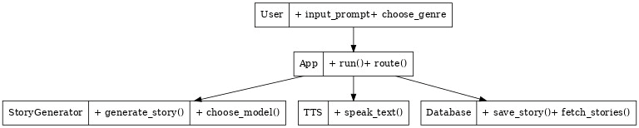
Class Diagram
The Class Diagram represents the main components (or classes) in the project and their relationships. Key classes include:
App (Flask application)
Story Generator (handles AI model selection and generation)
TTS (manages browser-based text-to-speech)
Database (saves and retrieves stories)
User (interacts with the system)
This diagram helps understand the structure of the system, showing what data and functions each part has.

Slide 14
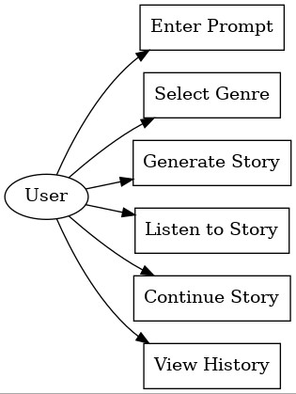
Use Case Diagram
The Use Case Diagram shows the interaction between the user and the system. It includes actions like:
Entering a prompt
Selecting a genre
Generating a story
Listening to the story
Viewing story history
It helps define what the user can do with the application and what the system must support.

Slide 15
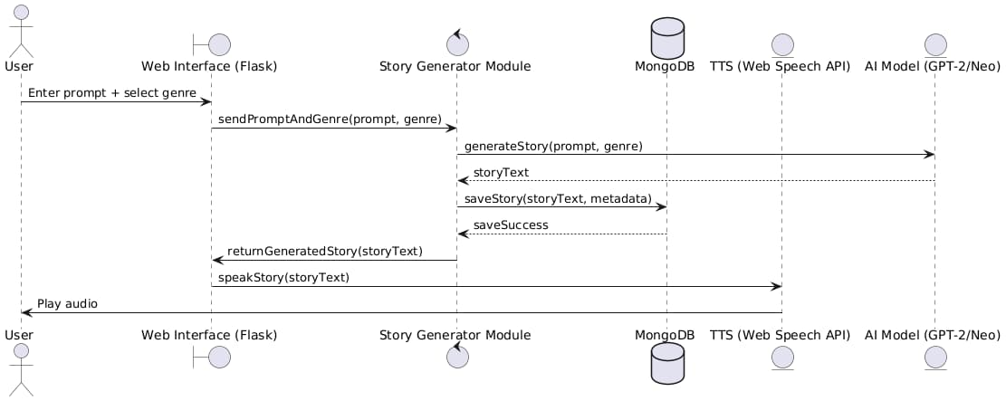
Sequence diagram
The Sequence Diagram outlines the order of operations between components during a single-story generation session. It shows the timeline of interactions:
User sends input to the web app
Flask routes the request to the generator
The model generates the story
The story is saved to the database
The result is returned and optionally sent to TTS
This diagram shows how components communicate in sequence to complete a task.

Slide 16
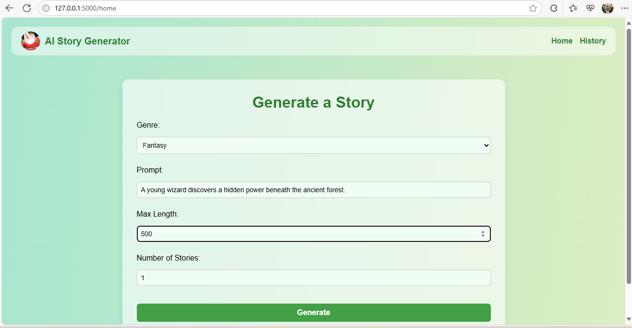
Output Screenshots
index.html prompt input

Slide 17
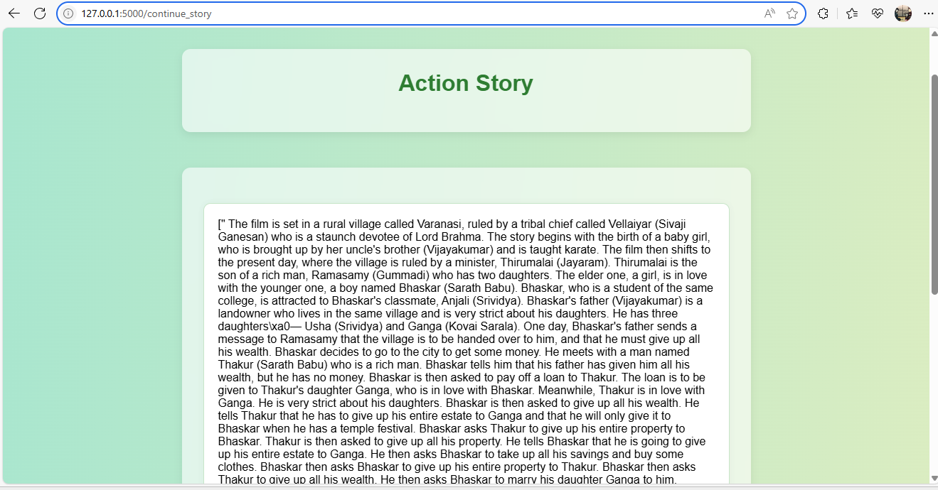
generated.html story output + TTS
Generated Story

Slide 18
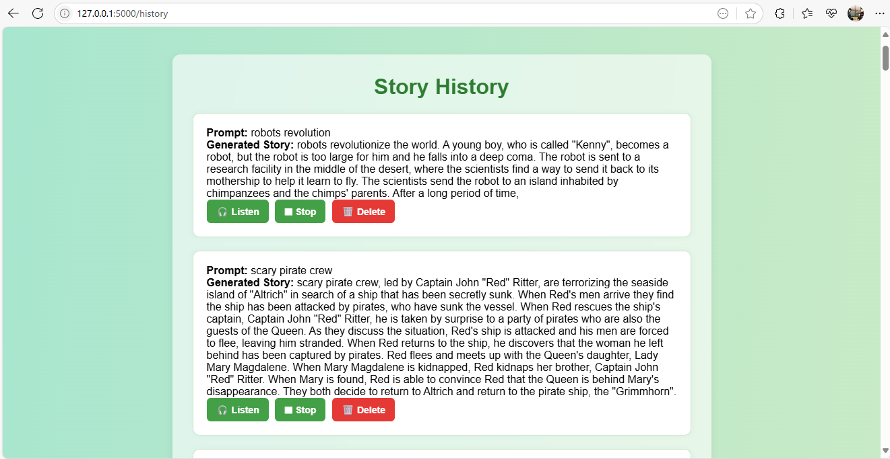
history.html story history list with TTS & delete
History Page

Slide 19
Conclusion
The AI Story Generator enables users to create, listen to, and manage stories using local AI models such as GPT-2, GPT-Neo, and afshaan/AIstoryGenerator-v2. It supports genre-specific generation, browser-based text-to-speech, and story history storage using MongoDB.
While story generation and TTS work offline, the project currently requires
internet connectivity for MongoDB operations (if using a cloud database like
MongoDB Atlas).It offers a semi-offline, interactive, and user-friendly platform for creative storytelling.

Slide 20
Thank You

